Slide 1

Laravel Lifesavers
Spatie Packages you may need

Slide 2
LARAVEL BACKUP | LARAVEL ACTIVITY LOG
LARAVEL MEDIALIBRARY | LARAVEL QUERY BUILDER
LARAVEL TRANSLATABLE | LARAVEL SIGNAL AWARE COMMAND
LARAVEL TAGS | LARAVEL HONEYPOT
REGEX | LARAVEL SCHEMALESS ATTRIBUTES
LARAVEL HEALTH | LARAVEL PDF
LARAVEL RESPONSECACHE | LARAVEL SCHEDULE MONITOR
OPENING HOURS | LARAVEL WEB TINKER
 | LARAVEL QUICK LOGIN

Slide 3


Slide 4


Slide 5
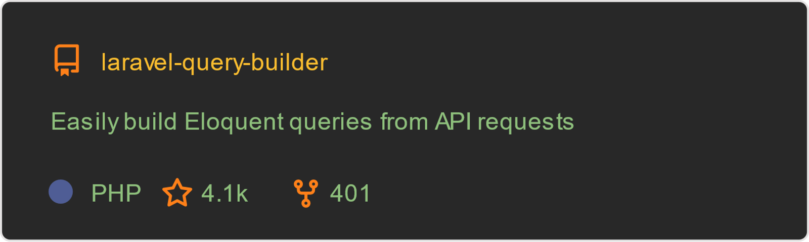

Slide 6


Slide 7


Slide 8
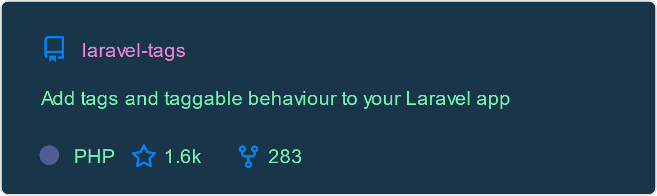

Slide 9


Slide 10


Slide 11
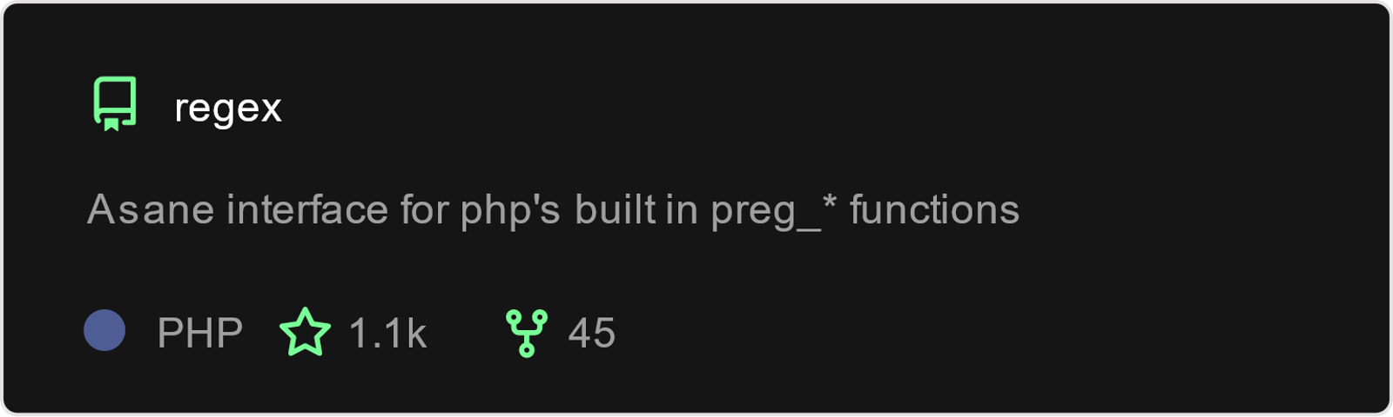

Slide 12


Slide 13


Slide 14


Slide 15
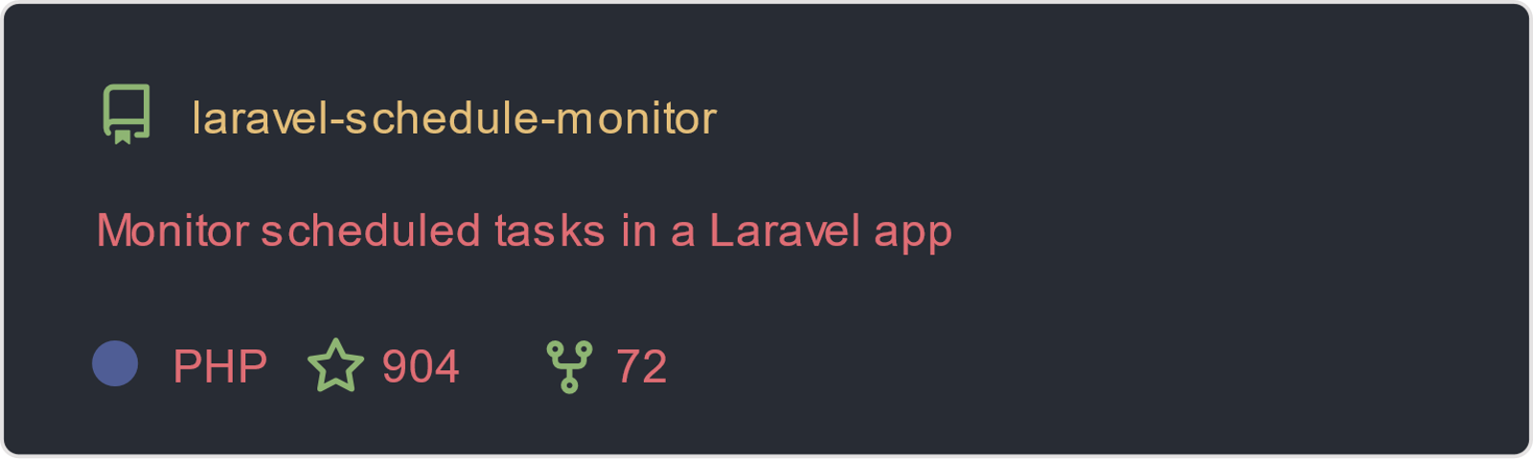

Slide 16
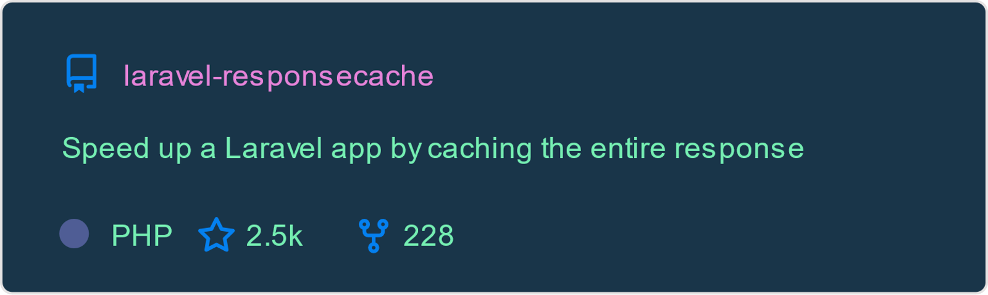

Slide 17


Slide 18
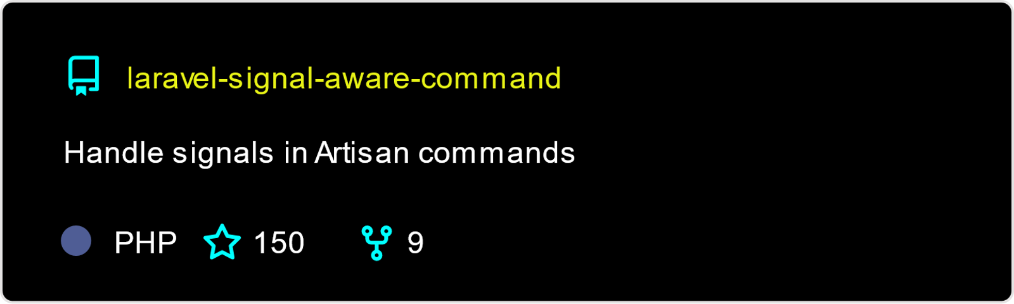

Slide 19
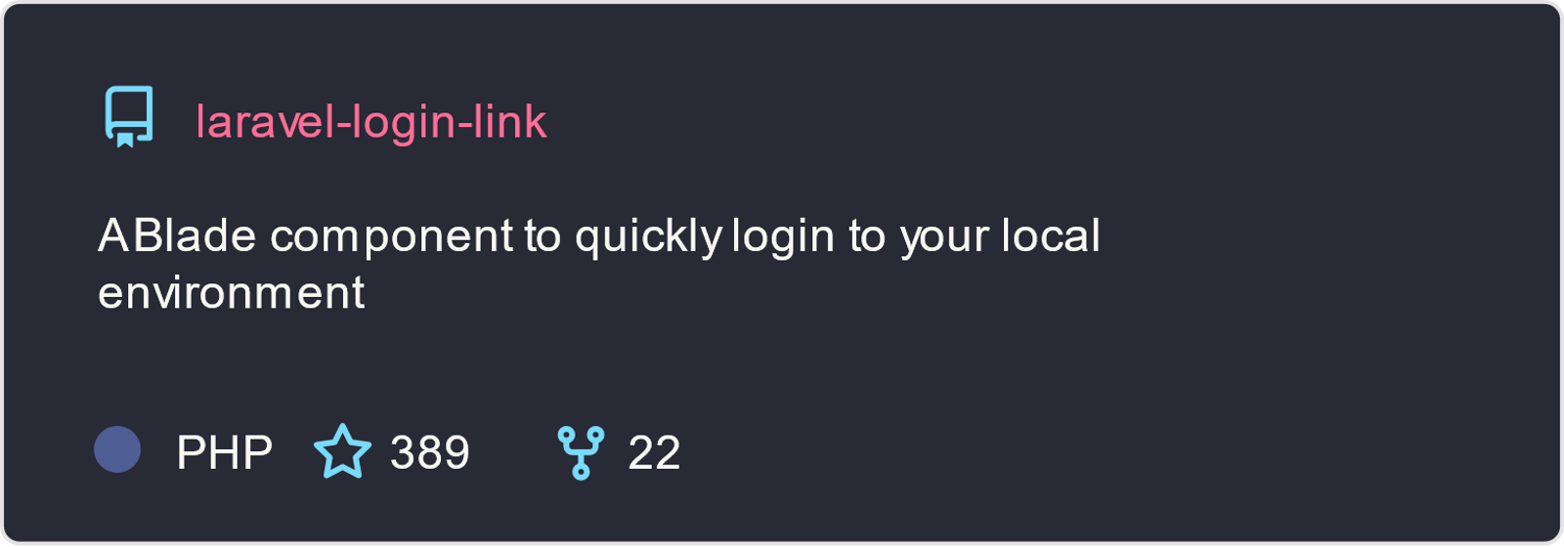

Slide 20
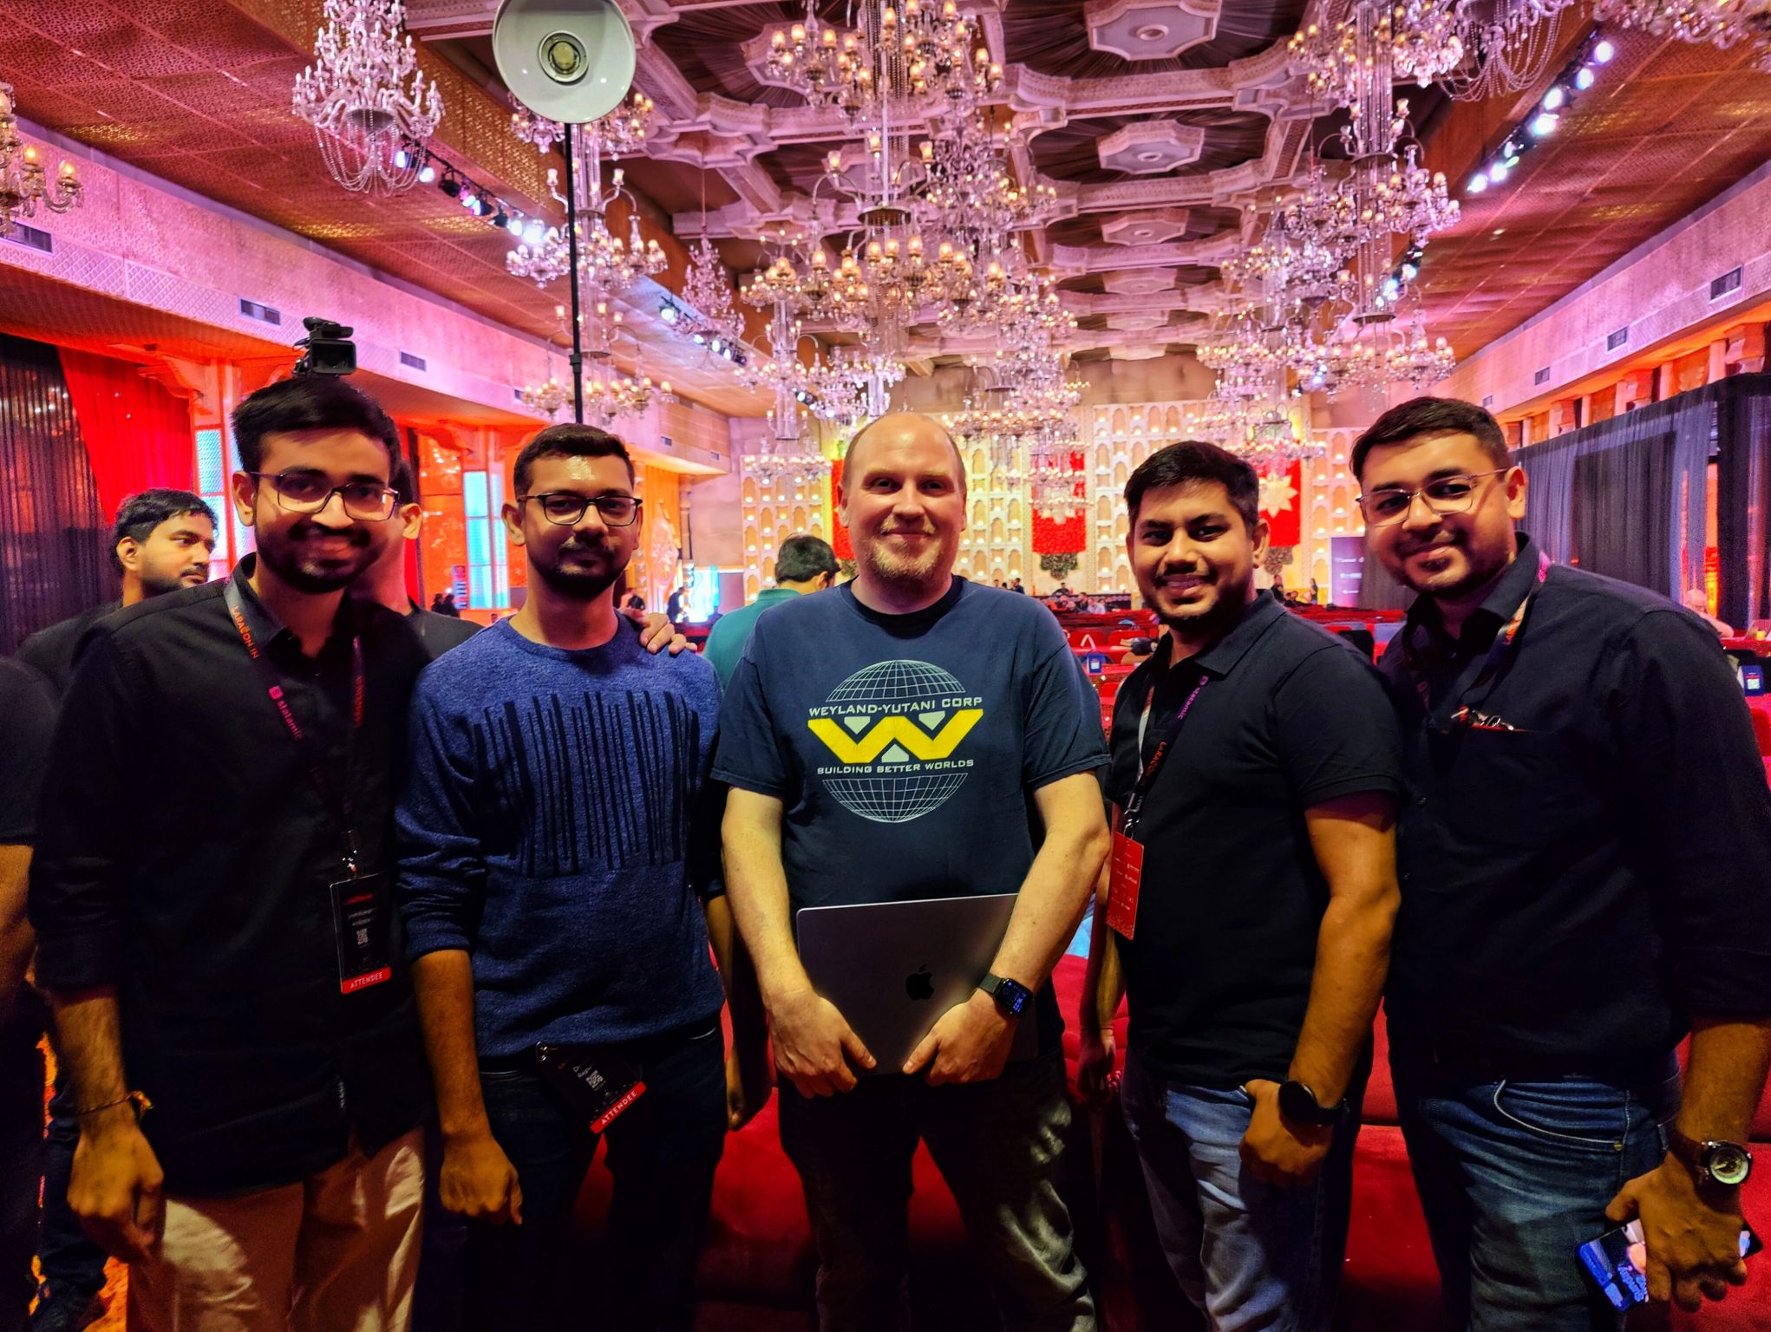
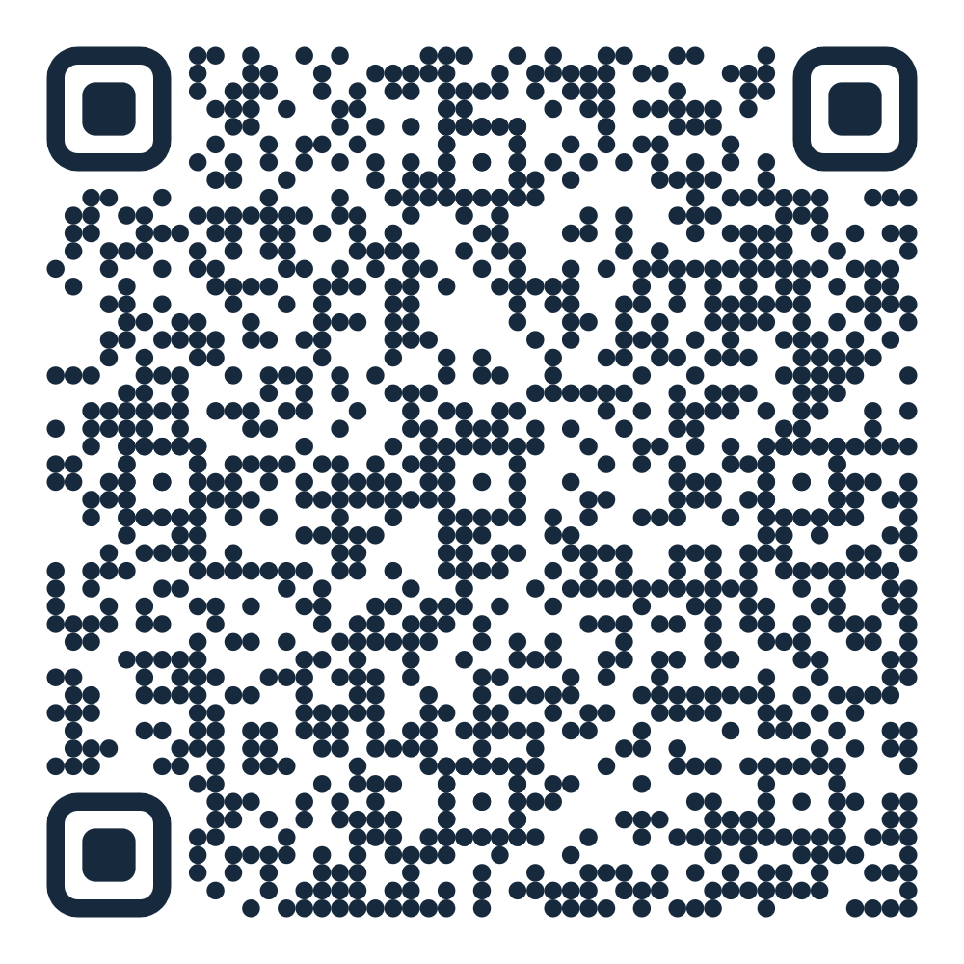
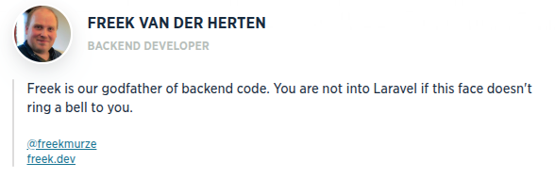
CODE AND PRESENTATION
Freek Van der Herten at Laracon 2024

